Slide 1

SHRI VISHNU ENGINEERING COLLEGE FOR WOMEN(A)
Vishnupur,Bhimavaram ,West Godavari , Andhra Pradesh , 534202
Recognized by AICTE , Permanent Affiliated to JNTUK-Kakinada , Accredited by NAAC with A+ Grade
Accredited by NBA in TIER-I Category DEPARTMENT OF CSE
Automated Exam-sheet Grader
Guided By:
Dr . Pokkuluri Kiran Sree, Professor & HOD
Presented by: Batch-A1 ​
A . Sri Leela Satya Ratnam – 23B01A0508 ​
B . Jhansi Lakshmi – 23B01A0516 ​
B . Sai Siva Harini – 23B01A0520 ​
D . Tejo Kumari – 23B01A0538 ​
G . Vahnita – 23B01A0558 ​
A . Hema Sri – 24B05A0501 ​
​

Slide 2






The Automated Exam Sheet Grader is an AI-powered examination management system designed to simplify and enhance the examination and evaluation process. The system provides separate portals for teachers and students, allowing teachers to create, manage, and monitor examinations, while students can participate in exams and view their results. The system also generates detailed performance reports, grades, strengths, weaknesses, and improvement suggestions. Overall, the project improves efficiency, transparency, and reliability in the examination process.
ABSTRACT

Slide 3

The increasing use of digital technology in education has transformed the way examinations are conducted and evaluated. Traditional evaluation methods are time-consuming and require significant manual effort.
The Automated Exam Sheet Grader is designed to simplify examination management and student evaluation. It enables teachers to manage examinations efficiently, while students can attend exams and access their results through a dedicated portal. The system also provides performance analysis, including grades and feedback.
The main objective of this project is to reduce manual workload and provide faster, accurate, and reliable evaluation with an improved user experience.
INTRODUCTION

Slide 4
LITERATURE SURVEY
Author / Year | Highlights | Source
Samuel Tobler et al. (2024) | Developed a Generative AI-based grading system that evaluates student answers using sample solutions and grading instructions. It automatically assigns scores and generates feedback, reducing manual evaluation effort. | Smart Grading: A Generative AI-Based Tool for Knowledge-Grounded Answer Evaluation in Educational Assessments
Kamalpreet Kaur et al. (2024) | Proposed an automated subjective answer evaluation system where the system scores answers based on semantic similarity and provides accurate grading. | Expert Systems with Applications

Slide 5
DOMAIN KNOWLEDGE
Backend
SpringBoot
MongoDB
JWT
FastAPI
AI Integration
Frontend
HTML
CSS
React
Tailwind CSS + shadcn/ui

Slide 6
MODULES
Authentication & Authorization
Secure login and role-based access for teachers and students.
Exam & Question Management
Teachers create, manage, and schedule exams with questions.
Student Examination Module
Students attempt exams and submit answers.
Teacher Evaluation Module
Teachers review AI results and manually re-evaluate answers if needed.
AI Intelligent Evaluation & Result Management
AI evaluates answers, generates feedback, and provides performance analytics.
Database Module
Stores users, exams, questions, attempts, results, and analytics securely.

Slide 7
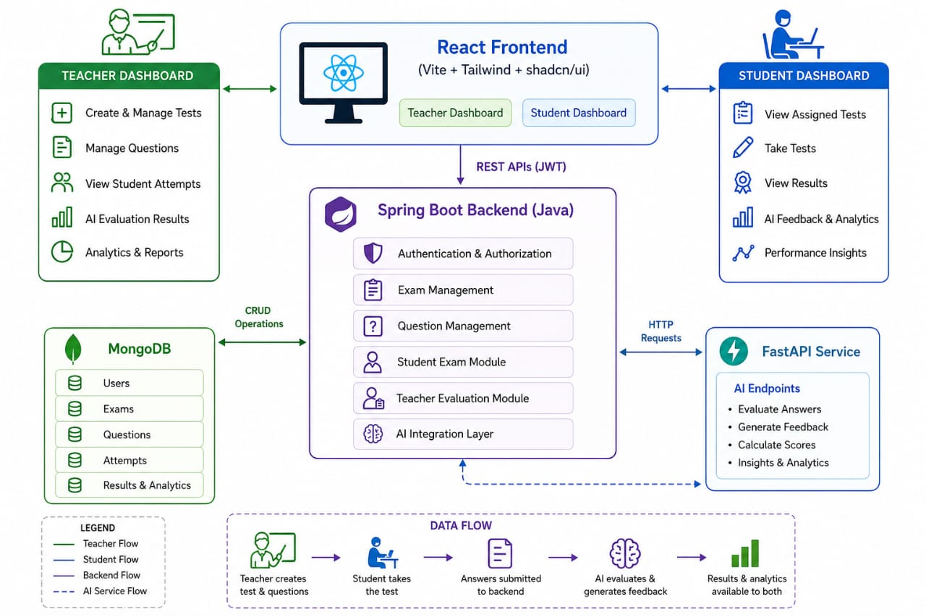
WORK FLOW

Slide 8
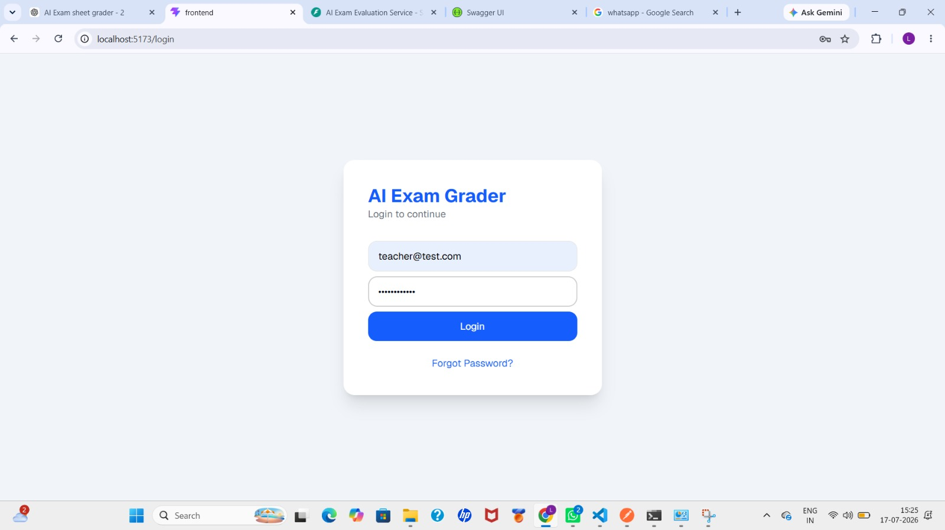
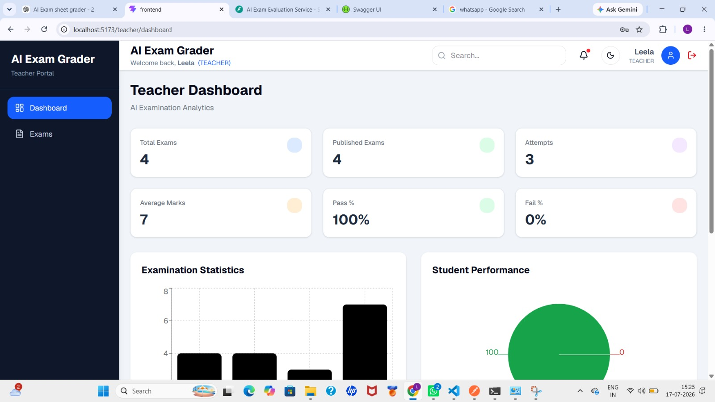
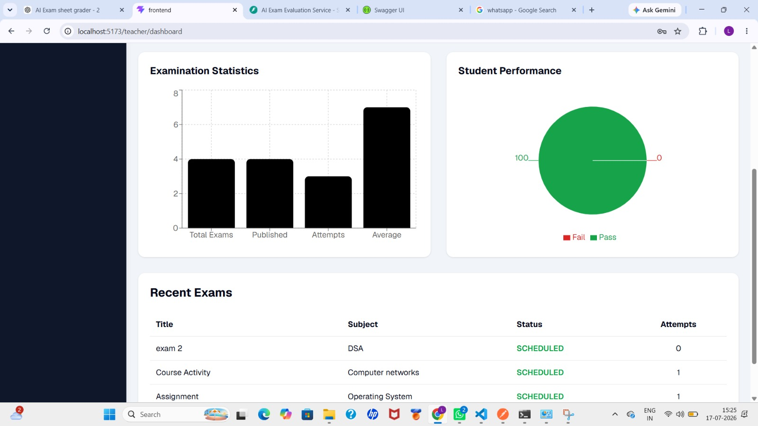
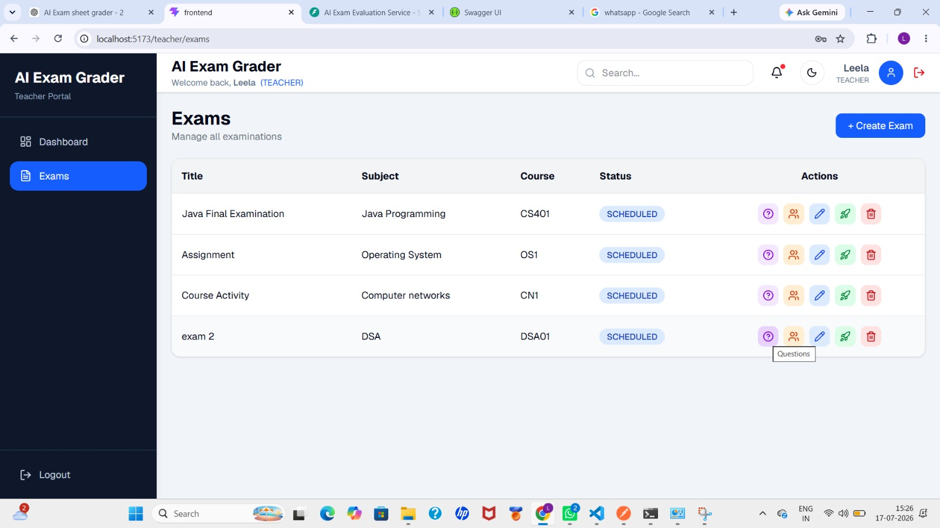
SCREENSHOTS

Slide 9
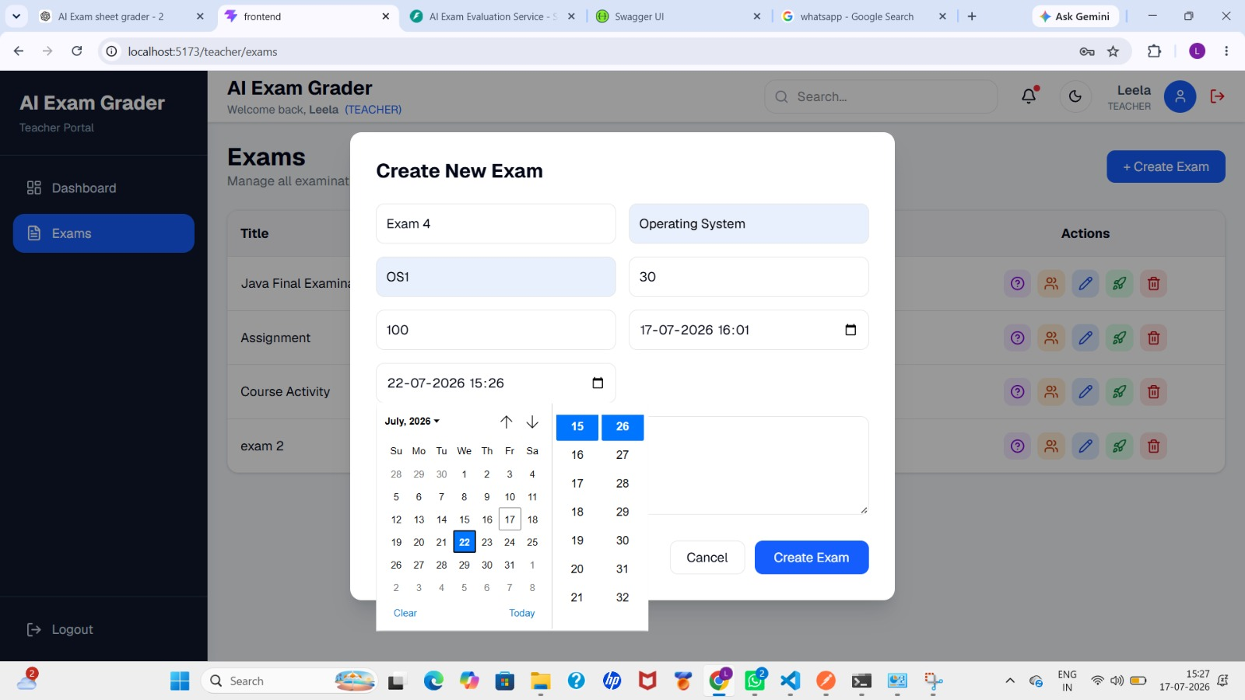
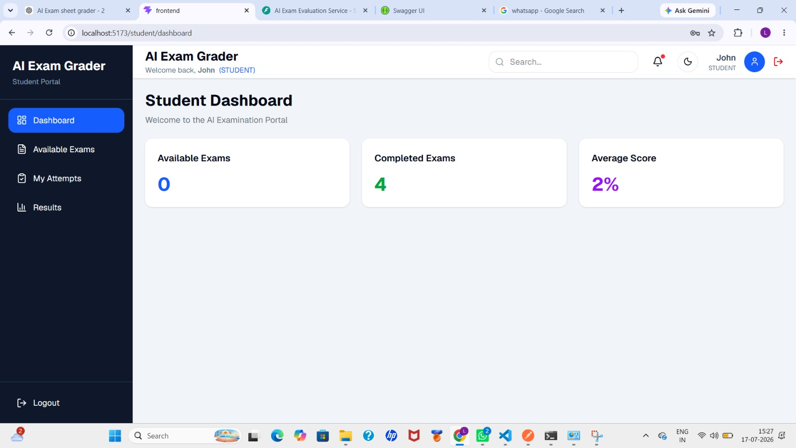
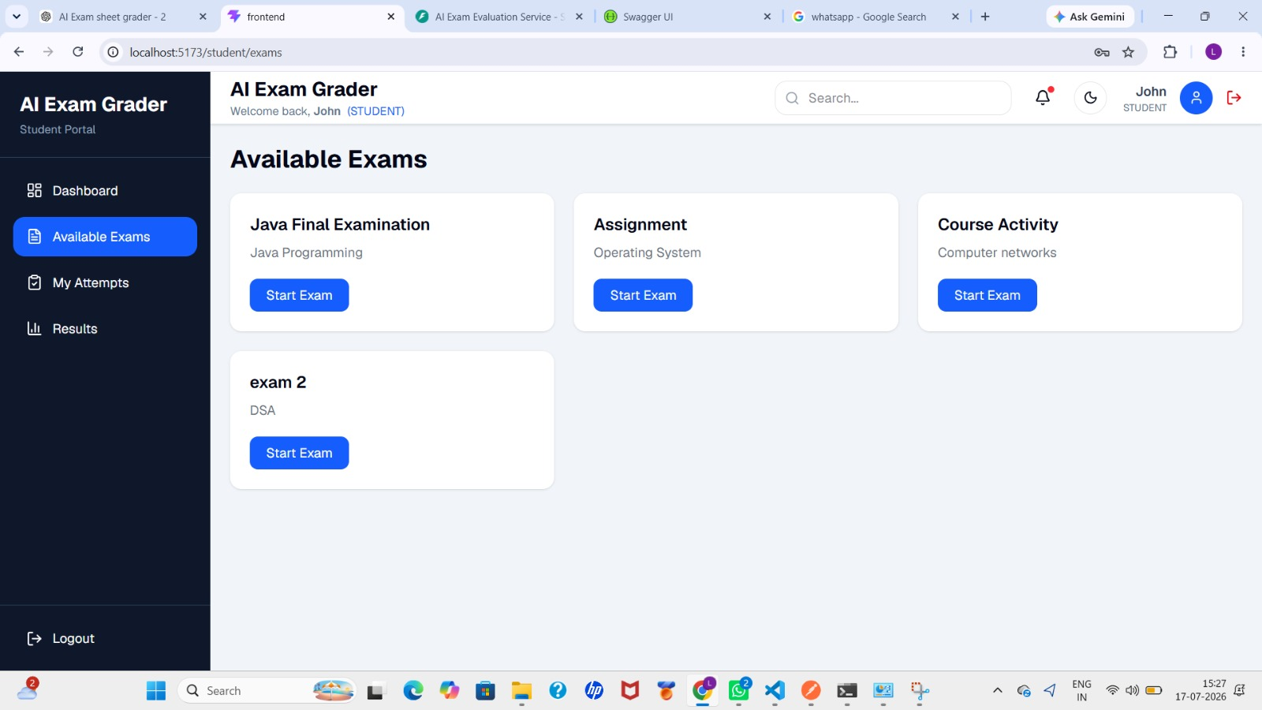
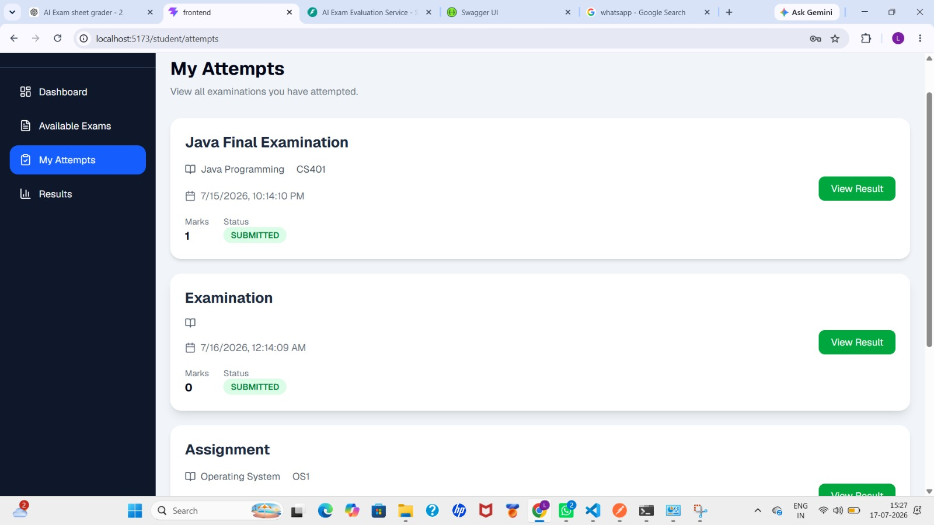

Slide 10
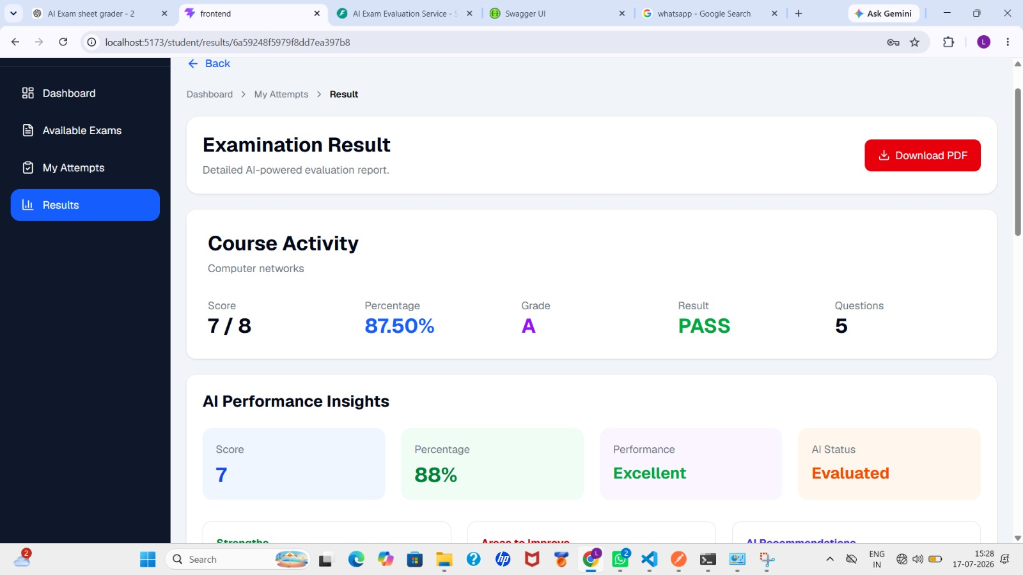
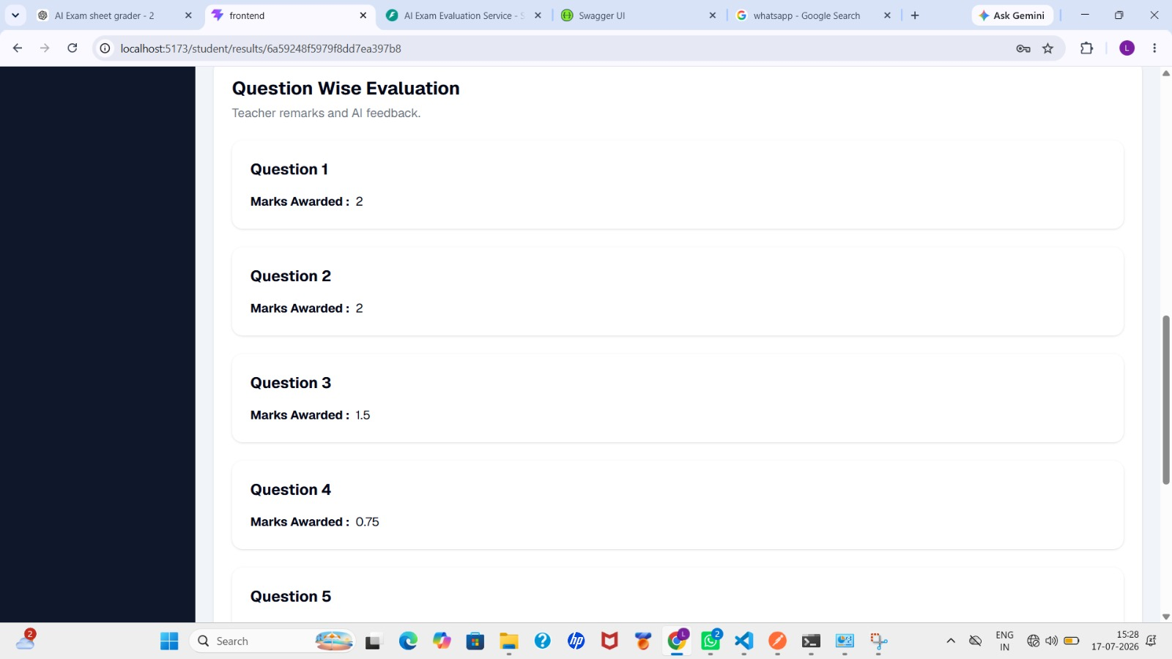
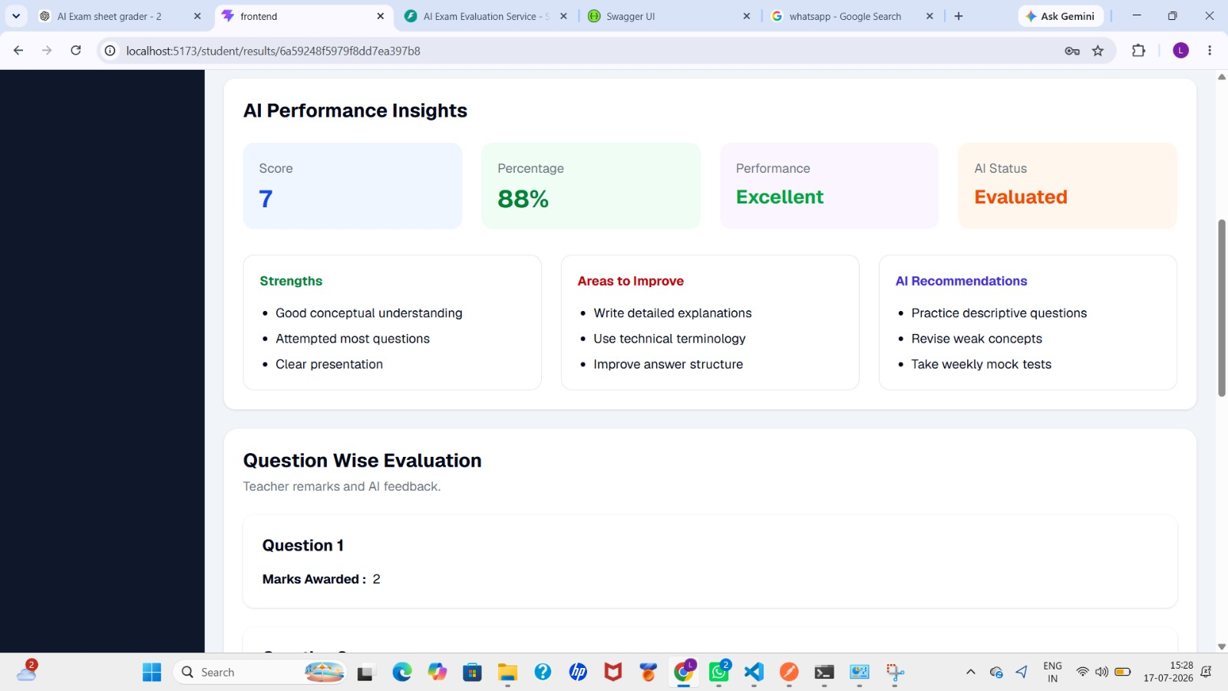
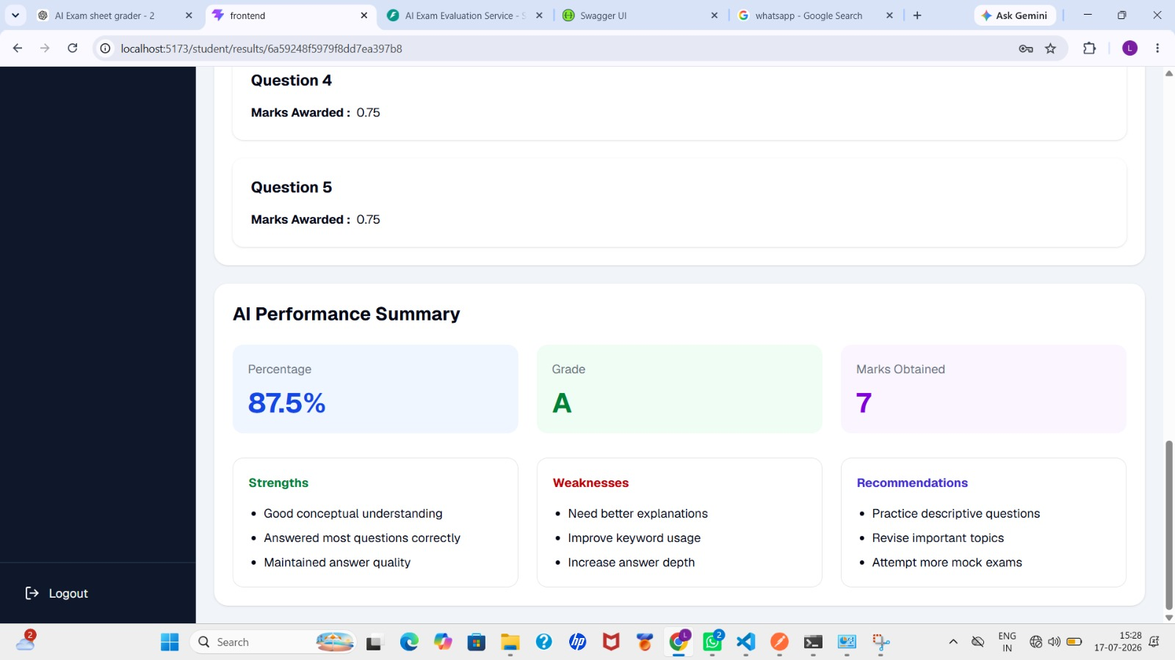

Slide 11


Slide 12
REFERENCES
J. Satya Vaishnavi, K. Aparna, Exam Eval: An Automated Model For Correcting Exam Papers, Journal of Web Engineering & Technology, Vol. 10, No. 3, 2023.
Naman Agnihotri, Harshvardhan Grandhi, Dhanashri Patil, Sanika Kharade, Ai-powered Exam Assessment System for Handwritten Answer Sheets, International Journal of Innovative Science and Research Technology (IJISRT), Vol. 10, Issue 3, 2025.

Slide 13
CONCLUSION
The Automated Exam Sheet Grader simplifies the examination and evaluation process by providing an efficient and user-friendly platform for teachers and students. It allows create to assessment, generates performance reports, and delivers timely feedback. By reducing manual effort and improving accuracy, the system makes examinations faster, more transparent, and more reliable, enhancing the overall teaching and learning experience

Slide 14
THANK YOU

